Slide 1

PADMAVATHI_JEWELLERY_MART
Instagram Report
BRAND
PERIOD
COMPARISON PERIOD
CHANNEL
@padmavathi_jewellery_mart
02 Jul 2026 - 31 Jul 2026
2 Jun 2026 - 1 Jul 2026
Instagram

Slide 2

Padmavathi Jewellery mart
EXECUTIVE SUMMARY
2/12
During the month of July 2026, Padmavathi Jewellerymart's Instagram activity showed a period of reduced engagement and follower growth compared to previous trends. The profile posted 16 times, slightly fewer than before, with an average of about half a post per day.Although the number of followers remained nearly stable at 563, there was a slight loss of 5 followers this month. Engagement per post fell significantly to 0.62%, indicating reduced interaction from the audience.Total interactions dropped to 56 likes and no comments this period, while video views marked a steep decline to 473. The reach and impressions also saw a substantial decrease, with average post reach falling to approximately 248 and total impressions around 4,505, much lower than past performance.Despite maintaining a high average of hashtags per post, the earned media value, both engagement and overall awareness, diminished sharply in alignment with other metrics. This suggests that the content did not resonate as strongly with the audience this month, affecting overall profile performance.
Source: Socialinsider
Date range: 02 Jul 2026 - 31 Jul 2026

Slide 3

KEY INSIGHTS
3/12
One month, three numbers
A quieter period — most metrics didn't gain as much traction as before.
0.62 %
4,505
3,961
Avg. Engagement Rate by Followers
Organic Posts Views
Organic Posts Reach
97.34%
96.33%
70.51%
Source: Socialinsider
Date range: 02 Jul 2026 - 31 Jul 2026

Slide 4
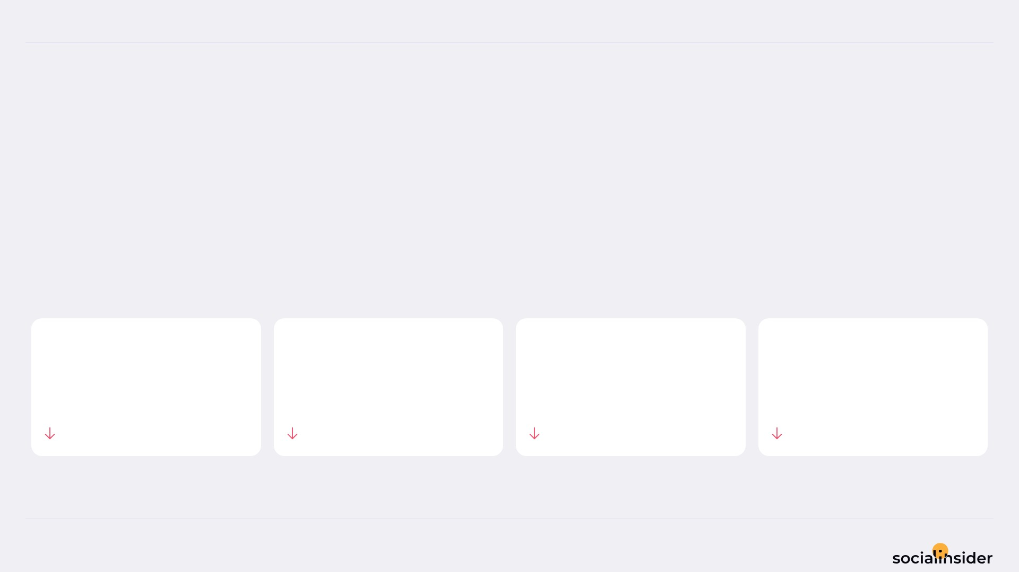
Padmavathi Jewellery mart
POSTS PERFORMANCE
4/12
POSTS TO ENGAGEMENT
Padmavathi Jewellery mart posted 11.11% less, and engagement followed.
TOTAL POSTS
TOTAL ENGAGEMENT
AVG ENGAGEMENT / POST
AVG ENGAGEMENT / DAY
16
56
3.5
1.9
11.11%
73.83%
70.56%
73.83%
Source: Socialinsider
Date range: 02 Jul 2026 - 31 Jul 2026

Slide 5
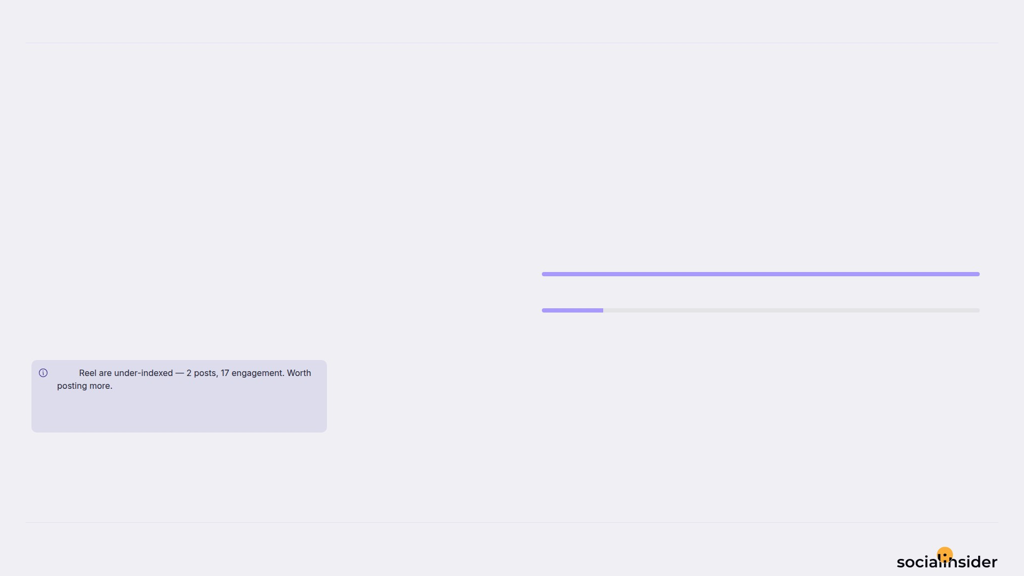
Padmavathi Jewellery mart
5/12
WHAT WE PUBLISHED
Image made up the majority of posts published during this period.
Image
14
Image accounted for 88% of posts and 70% of engagement.
Reel
2
Note
Source: Socialinsider
Date range: 02 Jul 2026 - 31 Jul 2026

Slide 6
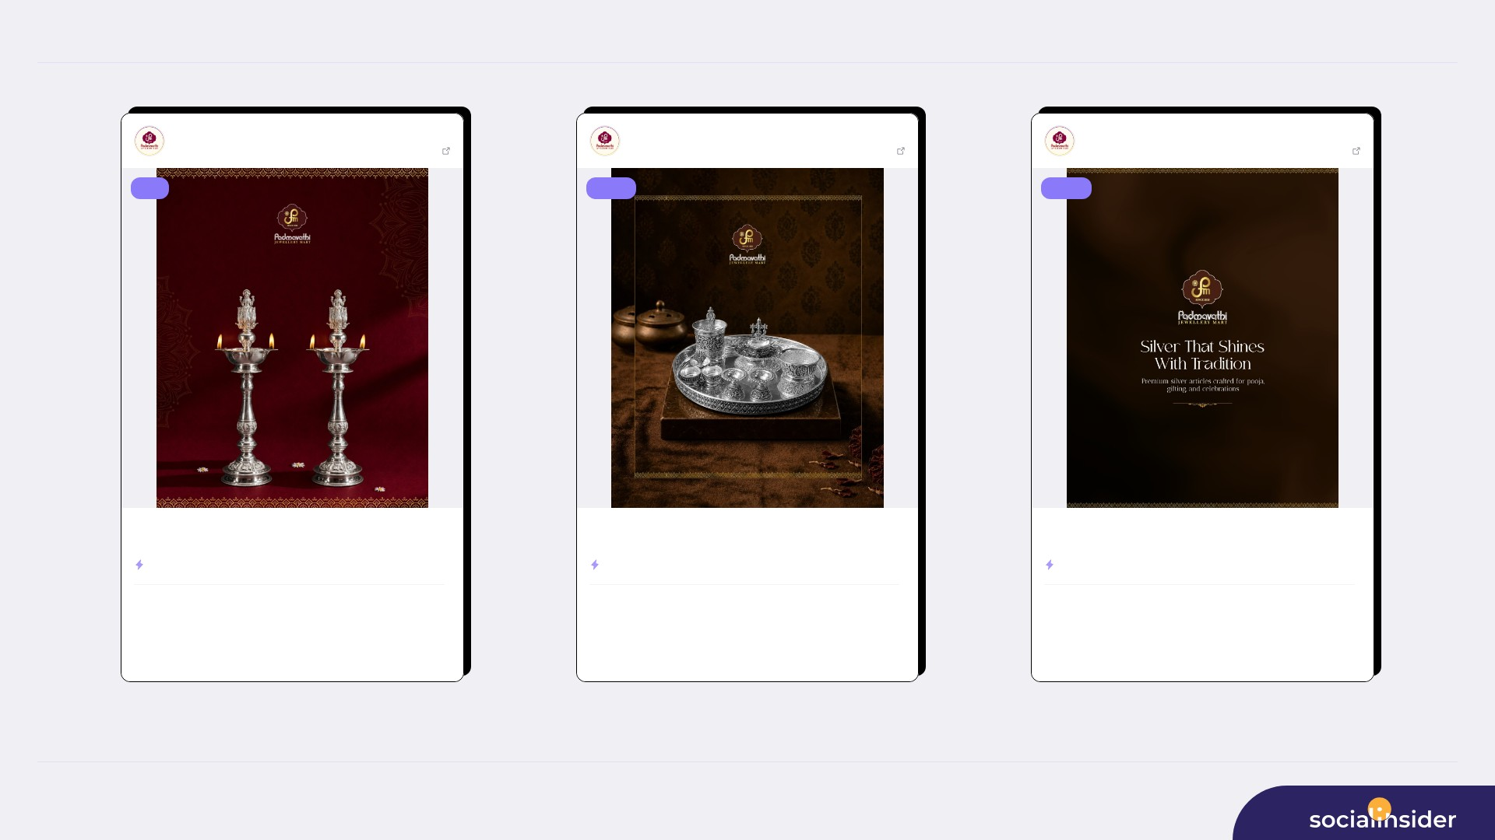
TOP CONTENT
6/12
Padmavathi Jewe...
Jul 20, 2026
Padmavathi Jewe...
Jul 13, 2026
Padmavathi Jewe...
Jul 02, 2026
563 followers
View post
563 followers
View post
563 followers
View post
reel
image
image
Light up your sacred moments with the elegance of silver. ✨ Discover ...
Add a touch of tradition and elegance to every ritual. ✨ Padmavathi J...
Silver that shines with tradition. ✨🤍 Explore premium silver article...
ENGAGEMENT RATE
2.31%
ENGAGEMENT RATE
1.07%
ENGAGEMENT RATE
0.89%
246
13
605
6
504
5
VIEWS
LIKES
VIEWS
LIKES
VIEWS
LIKES
0
153
0
550
0
458
COMMENTS
REACH
COMMENTS
REACH
COMMENTS
REACH
Source: Socialinsider
Date range: 02 Jul 2026 - 31 Jul 2026

Slide 7
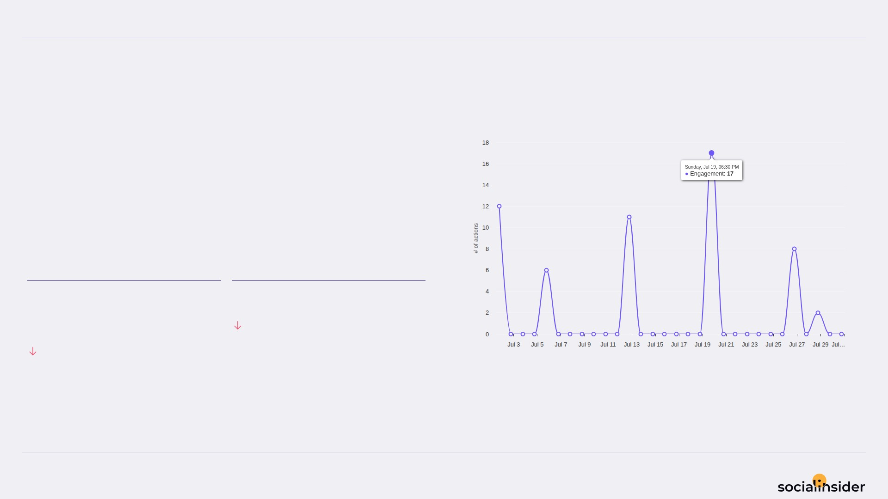
Padmavathi Jewellery mart
ENGAGEMENT
7/12
Engagement trend over the selected period
56 Total Organic Likes — a volatile period.
Both Total Organic Likes and Total Organic Comments declined this period.
TOTAL ORGANIC LIKES
TOTAL ORGANIC COMMENTS
56
100%
73.71%
Source: Socialinsider
Date range: 02 Jul 2026 - 31 Jul 2026

Slide 8
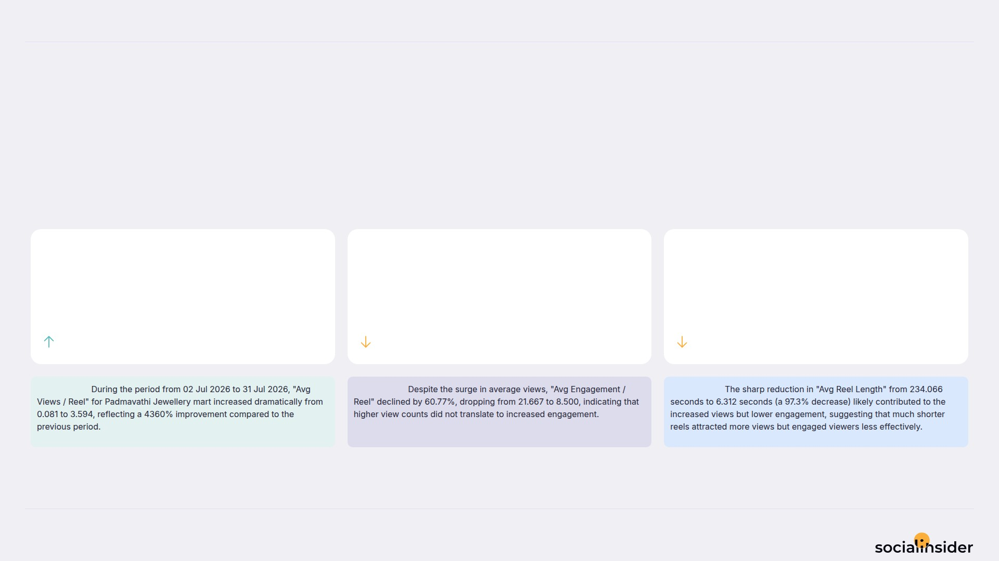
Padmavathi Jewellery mart
REELS
8/12
Key metrics for reels published during the period
A slower period for reels overall, with one metric bucking the trend.
AVG VIEWS / REEL
AVG ENGAGEMENT / REEL
AVG REEL LENGTH
3.6
8.5
6.3
4359.51%
60.77%
97.3%
Observation:
Observation:
Observation:
Source: Socialinsider
Date range: 02 Jul 2026 - 31 Jul 2026

Slide 9
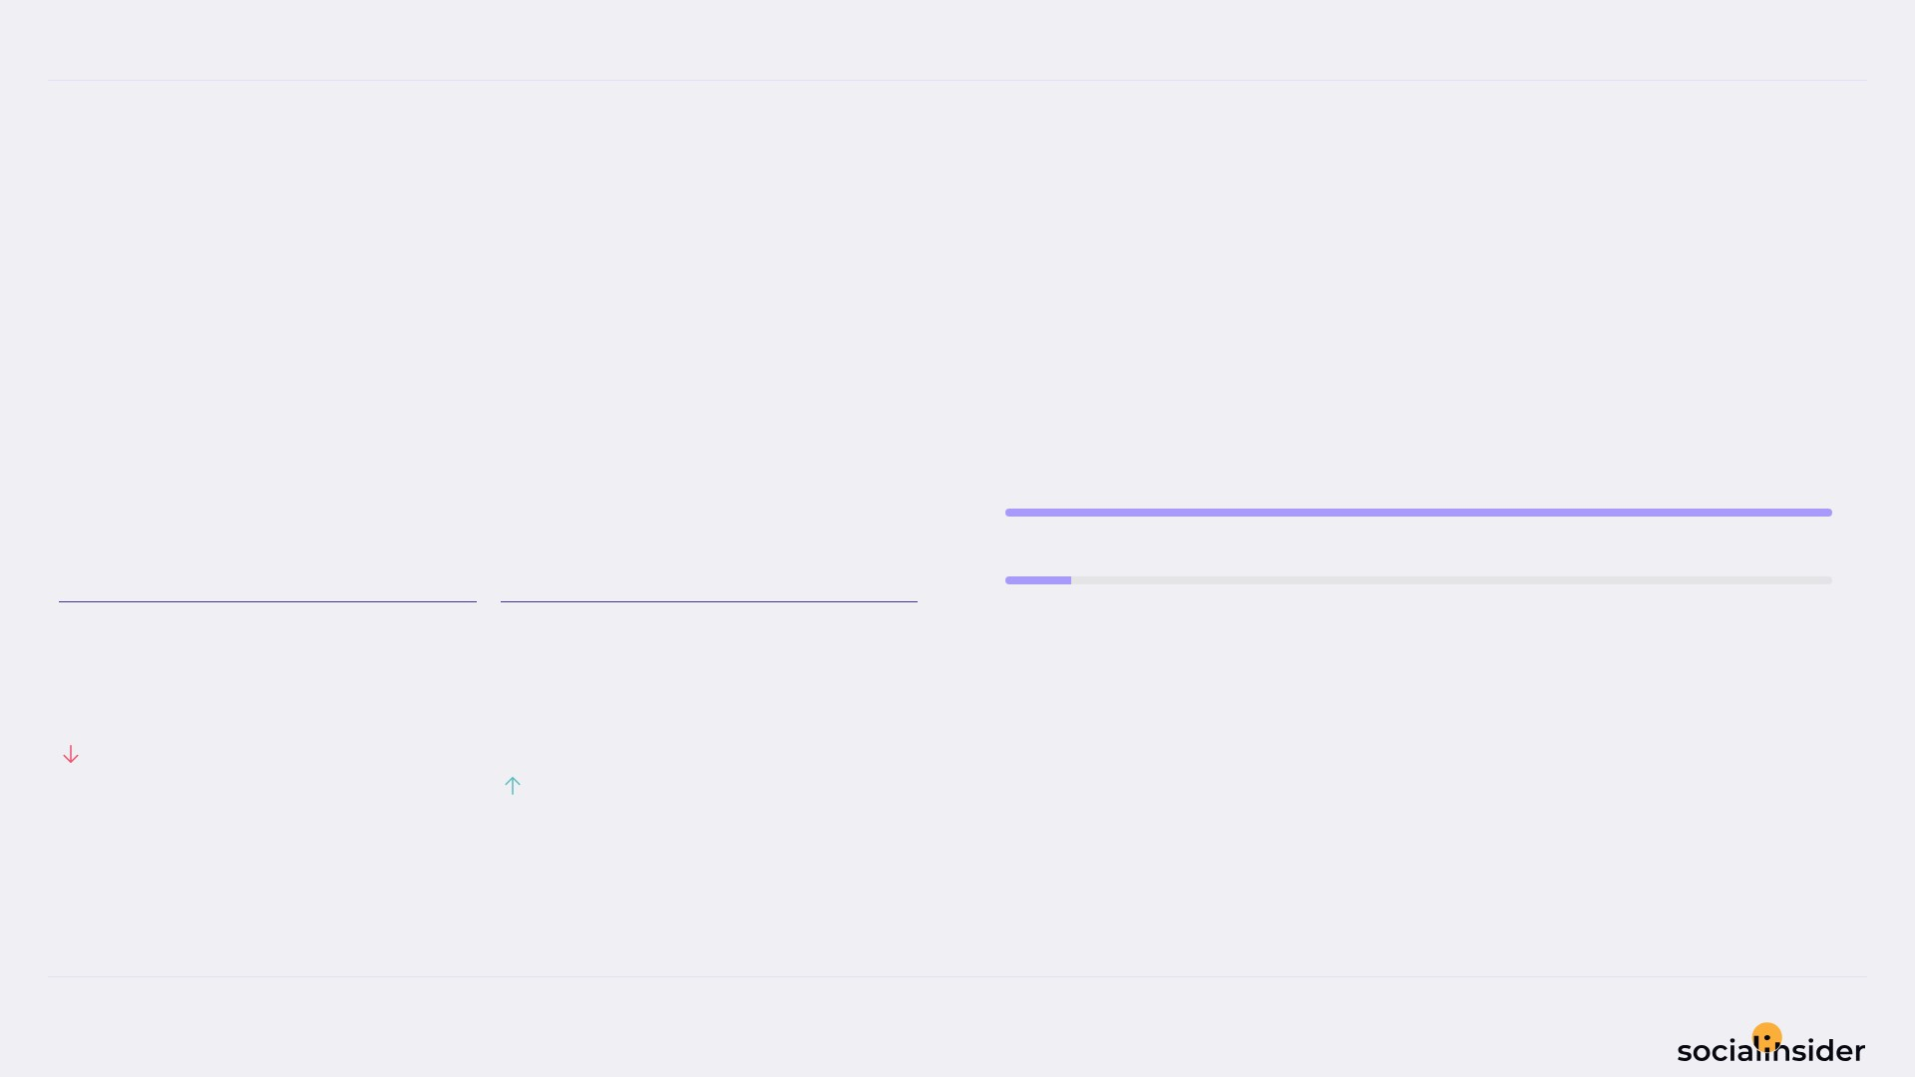
Padmavathi Jewellery mart
REACH
9/12
Reach performance broken down by post type
247.6 Avg Reach / Post — declining this period.
Avg Reach / Post fell while Avg Engagement Rate by Reach held — Avg Engagement Rate by Reach is the bright spot.
Image
4K
Reel
294
AVG REACH / POST
AVG ENGAGEMENT RATE BY REACH
247.6
1.6
%
96.33%
10.62%
Source: Socialinsider
Date range: 02 Jul 2026 - 31 Jul 2026

Slide 10
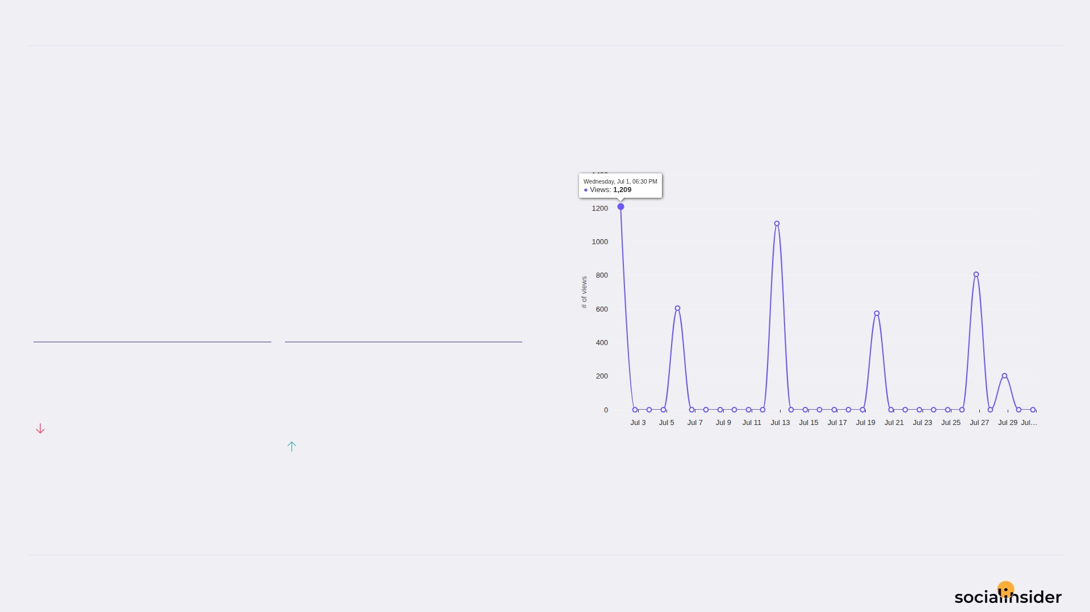
Padmavathi Jewellery mart
VIEWS
10/12
Views performance
281.6 Avg Views / Post — a volatile period.
Avg Views / Post fell while Avg Engagement Rate by Views held — Avg Engagement Rate by Views is the bright spot.
AVG VIEWS / POST
AVG ENGAGEMENT RATE BY VIEWS
281.6
1.2
%
97.01%
11.7%
Source: Socialinsider
Date range: 02 Jul 2026 - 31 Jul 2026

Slide 11
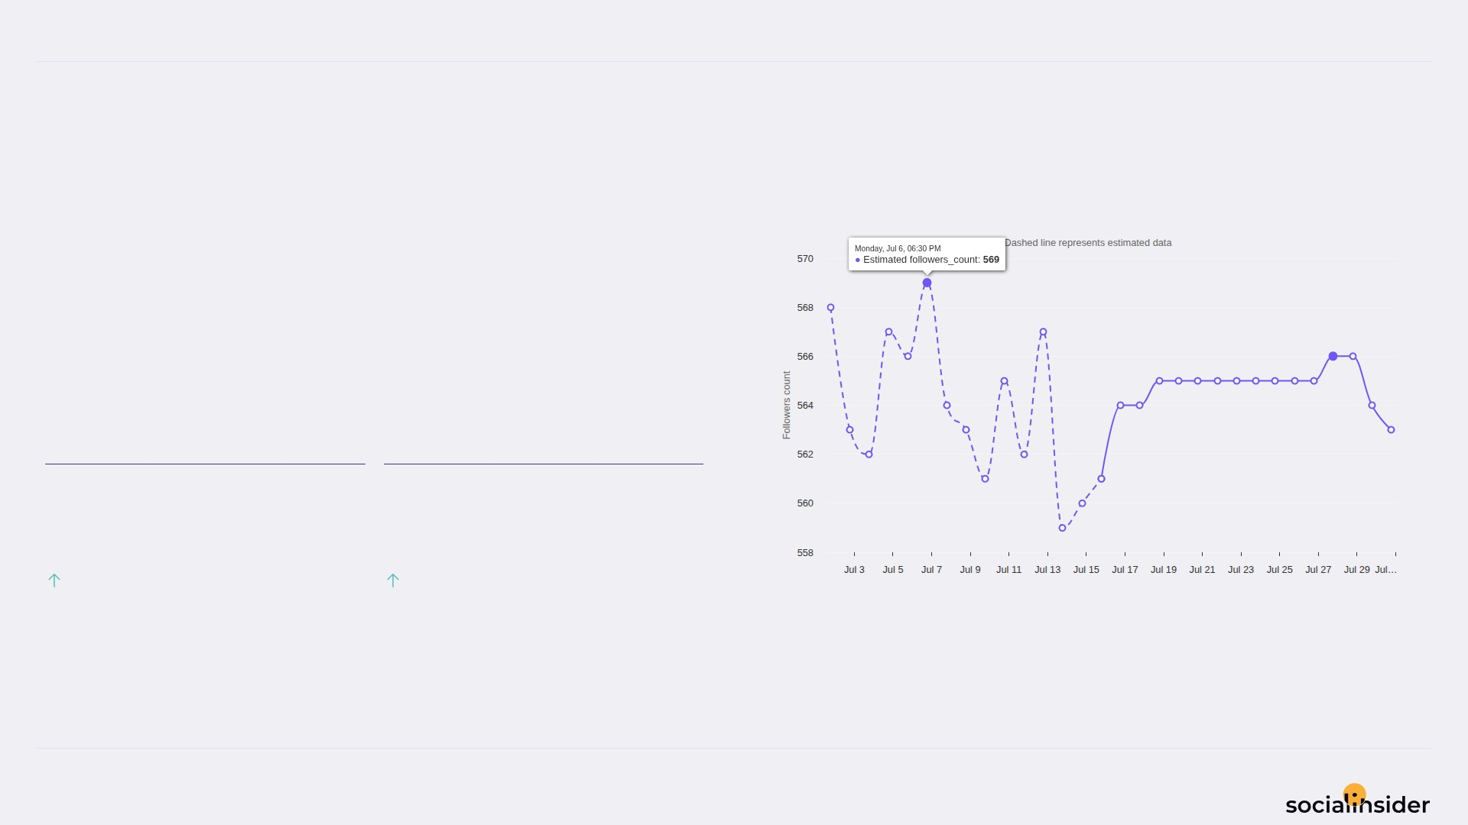
Padmavathi Jewellery mart
FOLLOWERS
11/12
Follower growth trend over the selected period
-5 Follower Growth — holding steady.
Both Follower Growth and Followers Growth % declined this period.
FOLLOWER GROWTH
FOLLOWERS GROWTH %
-5
-0.9
171.43%
170.05%
Source: Socialinsider
Date range: 02 Jul 2026 - 31 Jul 2026

Slide 12

REFERENCE
12/12
Definitions and reference materials for this report
Glossary & Resources
Scope
Definitions
Resources
Period
Engagement
Socialinsider Blog
02 Jul 2026 - 31 Jul 2026
The sum of likes and comments on the organic posts
socialinsider.io/blog
Comparison Period
Engagement Rate by Followers
Socialinsider Help Center
2 Jun 2026 - 1 Jul 2026
Engagement divided by follower count, expressed as a percentage
https://howto.socialinsider.io/en/
Social Channel
Reach
Socialinsider Studies
Instagram
Number of unique accounts that saw your content
https://www.socialinsider.io/reports
Content Analysis (posts analyzed)
Views
16
Total number of times your content was displayed
Source: Socialinsider
Date range: 02 Jul 2026 - 31 Jul 2026

